Slide 1
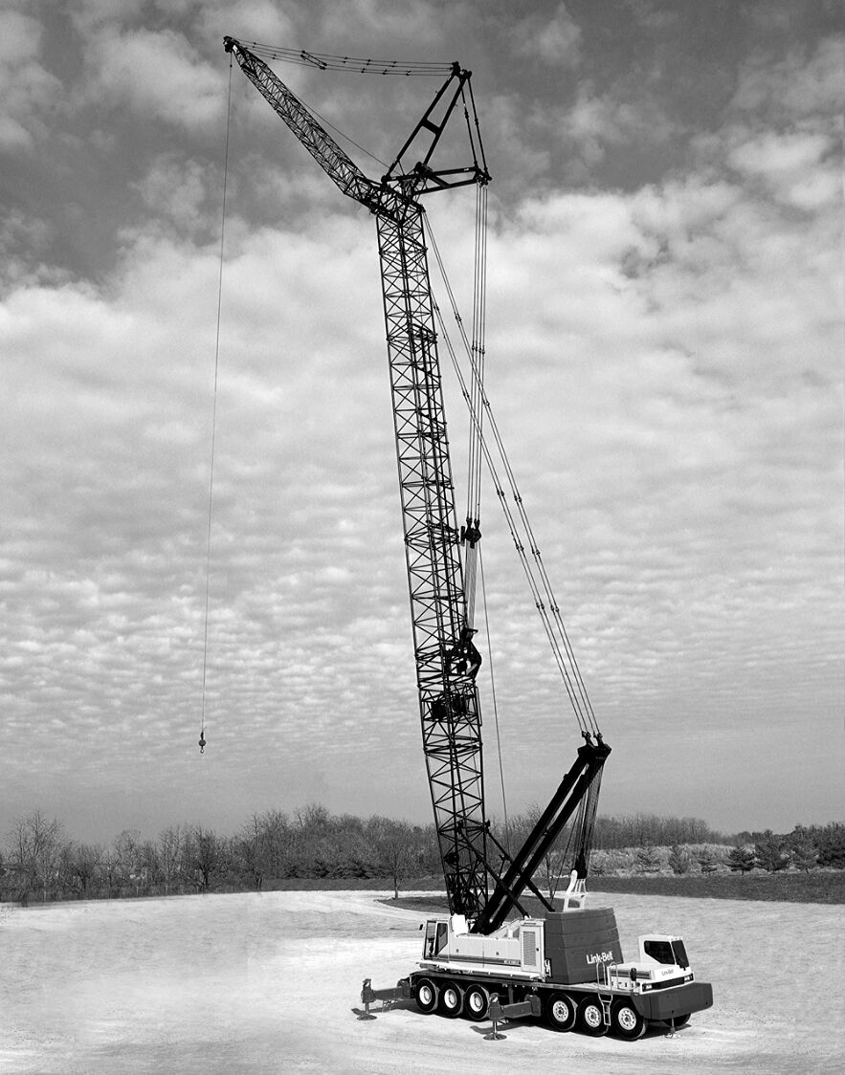

Build Your Future
[INSERT YOUR COMPANY NAME/LOGO]
Notes:
Insert your company name or logo.
Introduce yourself: Your name, position and company. Say you’re there to talk about a great career path that they don’t hear enough about – careers in construction.

Slide 2


What is Construction?
Notes:
Start off by posing a question: What is construction? See what answers your audience gives. See what words come to mind when they hear the word construction.
Transition by commending their answers and explaining how construction is an exciting and interesting industry that has a massive role in our society.

Slide 3


Notes:
Click the video to play it. If the play button does not automatically appear during the presentation, right-click the thumbnail and hit “preview,” and then click the play button on the video.
NOTE: Before playing video, make sure the sound is on and the computer or presentation is hooked up correctly. Be sure you are connected to the internet, as the video must connect to YouTube.
Feel free to stop playing at the 1 minute mark, as the closing slide includes a voiceover that isn’t necessarily relevant to the presentation.

Slide 4



IT IS everywhere
Notes:
Re-emphasize points made in the previous video. Everything starts with construction! Malls, hospitals, homes, stadiums, schools, offices, roads, factories. Without the construction industry, we wouldn’t have any buildings, any electricity, any running water or AC. Although we may not think about construction every day, it is an important part of our lives.
You can replace these photos with projects your own company has worked on. Give a few brief examples of the different projects your company is a part of.

Slide 5



Notes:
Continue your discussion of cool projects your company works on and provide more pictures. You can also talk about the different locations, size of project and any other interesting facts.
Insert your own project photos.

Slide 6




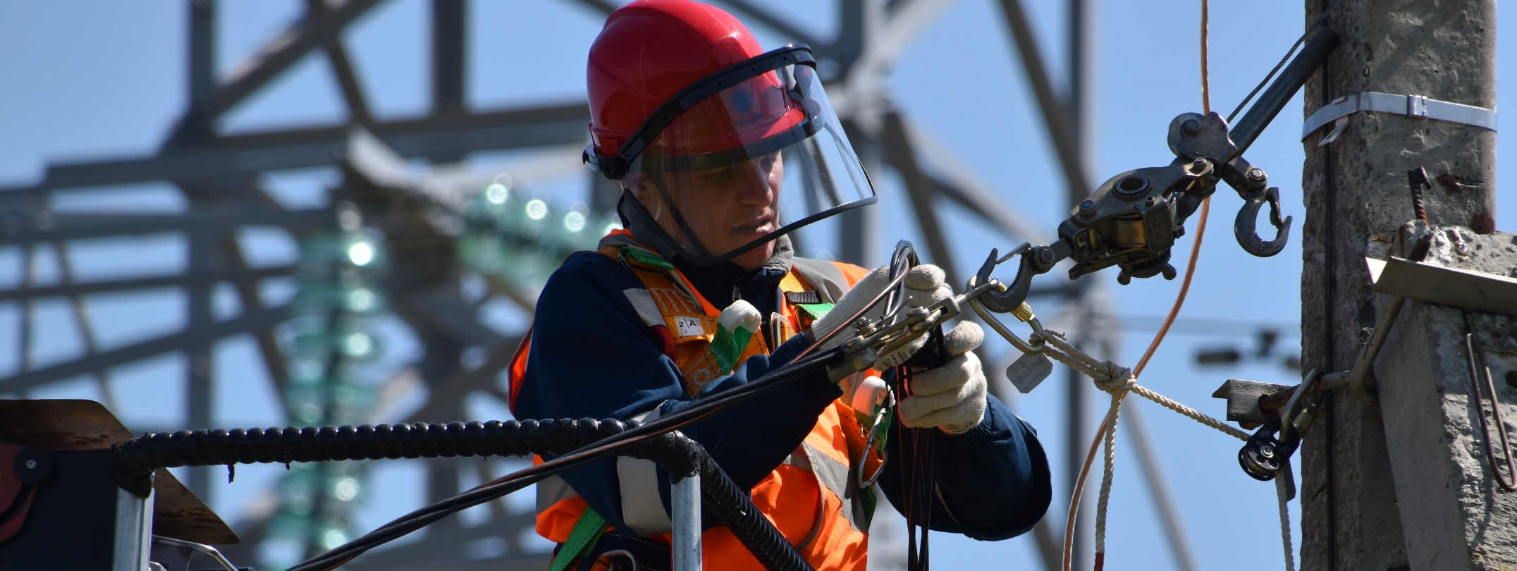
What goes into a construction project?
Carpentry
Masonry
Welding
Electrical
HVAC Technician
Civil Engineering
Plumbing
Heavy Machine Operation
…And more!
Notes:
Now that you’ve given an overview on the different types of construction projects, it’s time to look deeper into what actually goes into those projects: the craft skills!
Construction involves a lot of people with high skills working together.
Every building has a number of different components, and they all need compliment each other. For example, an air conditioning unit can’t function without the electrical and plumbing systems.
This is a great time to give insight and examples from your own company or your own experience. Which crafts does your company specialize in? What crafts did you do? How did individual crafts come together to successfully complete a project?

Slide 7

It’s not a
walk-up-and-get-a-job type of industry
You wouldn’t want someone who didn’t know what they were doing to build the roof over your head!
Craft careers require:
- Education
- Training
- Skill
Notes:
The purpose of this section is to dispel stereotypes surrounding the industry. Many people see construction as something anybody can walk up and do, and that you don’t need any training or talent.
But the crafts do require education and skill. Just like a doctor or a scientist or a businessperson go to school to learn how to do their jobs, craft professionals need to learn and practice. And it makes sense, because you wouldn’t want a critical piece of a building like a roof or power system to be built by someone who is not highly skilled.

Slide 8
education and training
Apprenticeship
Programs
Career & Tech EDUCATION
Community AND TECHNICAL college
university degree
Spend 20% of your time in school and 80% on the job, getting paid and learning from a professional in the field
Gain highly-specific and highly-versatile credentials for construction through hands-on programs in high school, or your local area
Four-year degrees that focuses on both construction and business to efficiently enter the workforce
Participate in construction craft training while earning college credit and obtaining a degree in two years
Notes:
These are 4 types of formal training craft professionals can receive. There are many different ways to learn a craft!
Give a brief explanation of each one. You can discuss your own experience about how you learned your craft and got into construction. If your company has an apprenticeship program or an affiliation with a school or other training program, mention them here.

Slide 9
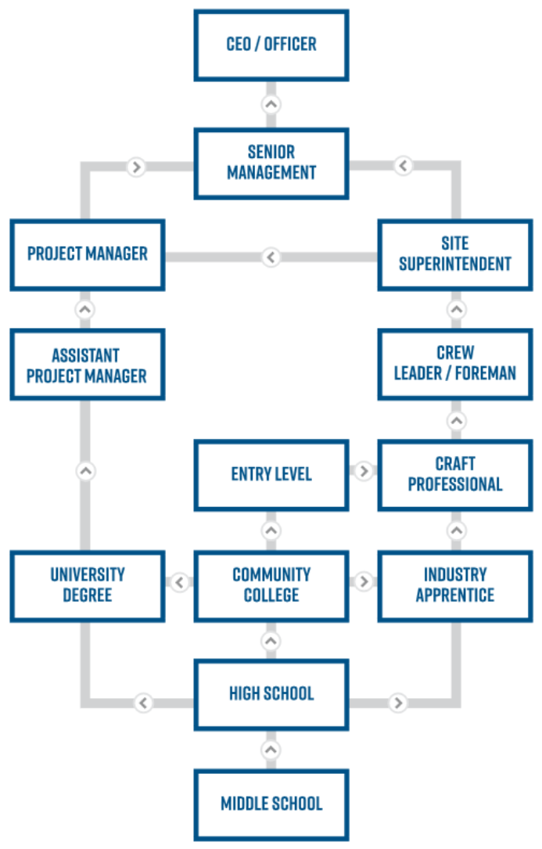
There are many paths to a construction career
There's always a way to gain training, secure the right credentials and begin a career in construction!
Notes:
Again emphasizing that there are many routes someone can take for a construction career.
If you want to immediately hop into the field and start earning money, an apprenticeship might be a good choice. But if you want a more traditional college experience, there are plenty of options through the community college or university path.

Slide 10

Notes:
Click the video to play it. If the play button does not automatically appear during the presentation, right-click the thumbnail and hit “preview,” and then click the play button on the video.
NOTE: Before playing video, make sure the sound is on and the computer or presentation is hooked up correctly. Be sure you are connected to the internet, as the video must connect to YouTube.
Feel free to stop playing at the 1 minute mark, as the closing slide includes a voiceover that isn’t necessarily relevant to the presentation.

Slide 11
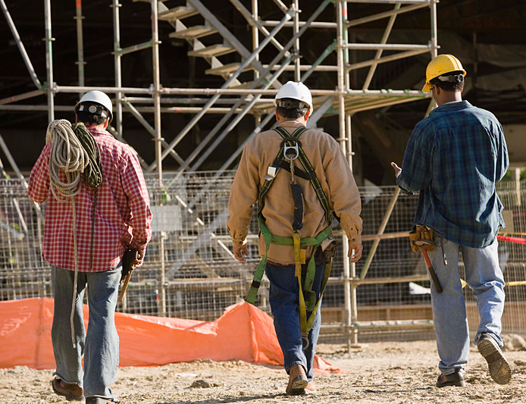
Why construction?
Great Pay
High Demand
Satisfaction and Happiness
Unlimited Potential
Leave a Legacy
Notes:
Now that your audience knows a bit more about construction and the crafts, it’s time to convince them why they should consider a career in construction.
What makes this a great career?
Skilled professionals are well-paid, and salaries continue to climb. If you personally made a nice living in construction, give some examples of how you are enjoying financial security!
Lots of students go to college, earn a degree, and then find there are no jobs in that field. Well, construction doesn’t have that problem. There is a growing demand for craft professionals, with an estimated shortage of 1.4 million construction workers by 2022. Craft skills are skills for real jobs that companies are actually hiring for. (Statistic from ManPower – Skilled craft positions continue to be in the top five hardest jobs to fill globally.)
Construction workers have a high degree of job satisfaction. A 2015 report found that, out of all industries, construction had the happiest employees.
Skilled craft professionals have unlimited potential. It is not a dead-end job. There are many opportunities to advance and grow your career. You can go from an apprentice to a manager or supervisor to a company executive or owner.
Finally, you have the ability to leave a legacy. You can drive by a building on the street and say “I helped build that.” The hospitals you build will help save lives. The schools you build will teach future generations.
Share why you personally enjoy your career in construction. Is it the friends you make and people you meet? Is it the ability to express your creativity or make an impact in the community? Is it the ability to give your family a comfortable life?

Slide 12
$100,000
Average Salary
$75,000
$50,000
Average base salaries for journeyman-level craft professions often push past $60,000 a year or more.
With travel bonuses and other incentives, you can make six figures!
$25,000
$0
Plumber
Electrician
Welder
Architect
Project Manager
Notes:
More information about salaries in support of the previous slide.
Many people think that construction workers are just laborers who have limited skills and limited options that don’t get paid much.
But the truth is construction workers are skilled craft professionals who enjoy their jobs and get paid well for their unique and in-demand talents!

Slide 13
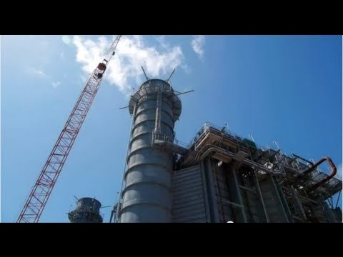
Notes:
Click the video to play it. If the play button does not automatically appear during the presentation, right-click the thumbnail and hit “preview,” and then click the play button on the video.
NOTE: Before playing video, make sure the sound is on and the computer or presentation is hooked up correctly. Be sure you are connected to the internet, as the video must connect to YouTube.
Feel free to stop playing at the 1 minute mark, as the closing slide includes a voiceover that isn’t necessarily relevant to the presentation.

Slide 14

Get in Touch
Address
123 Anywhere St., Any City, State, Country 12345
Phone
We'd love to hear from you!
123 456 7890
Email
hello@reallygreatsite.com
Notes:
Fill in your company contact information. If you have an apprenticeship program, include ways to get involved.
Thank the audience for their attention and ask if there are any questions.

